Slide 1
MS Leadership development program 2015 FDFM Walkthrough
Success is about freeing people to develop and build customer relationships. It’s about high-value activities…

Slide 2
The first rule of any technology used in a business is that automation applied to an efficient operation will magnify the efficiency. The second is that automation applied to an inefficient operation will magnify the inefficiency.
–Bill Gates

Slide 3
Meeting Agenda
FDFM Tool quick Background & Overview.
Phase #1
Faced Obstacles.
FDFM tool walkthrough.
FDFM Outputs & Achievements.
Phase #1 Cont. (SDP2)
Reset Actions figures.
Reset Actions effect on the Network KPIs.
Figures of outputs after including Auto Reset in FDFM tool. Phase#1 finalizing.

Slide 4
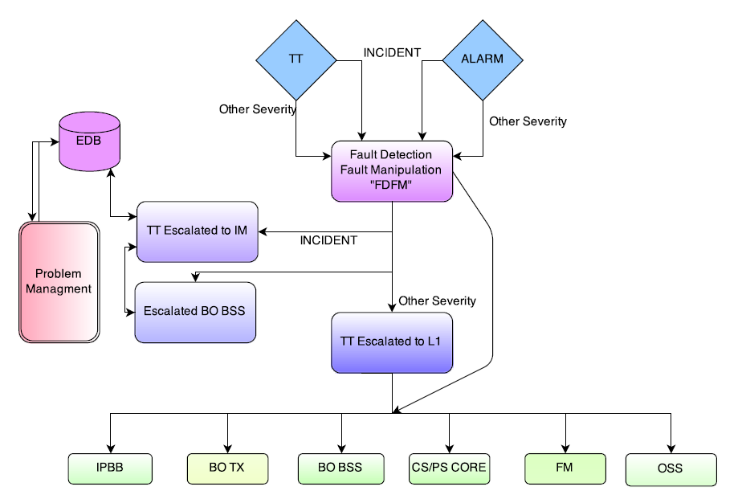
FDFM Tool quick Background & Overview.
Direct Link to Proactive Pro Management
Automatic Triggering for a problem.
Pull-down Menu
Node
Sub node
Service Affected
Incidents Auto - Assigned
Automatic Severity & SLA (KPI Fetched, Alarm Class)
Alarm Check/Log & L1 Troubleshoot (Reset if needed)
Automatic Forwarding/Escalation
Permanent Solution Probability.
Automatic Check on Route for displaying all Route Errors (Alarms)
Estimation of root cause and way forward in KPI’s degradations.
DOUBLE CLICK PHSASE#1 WORKING SAMPLE HERE →

Slide 5

Phase #1 (SDP1) Faced Challenges.
High Number of Cabinets Alarms.
Cabinets defined Structure Anatomy.
Cabinets defined SW Structure Anatomy.
Alarms/MO Colorations.
Alarms descriptions & Decoding.
Alarms History Decoding.
Related CRs for each site.
TX Path checking versus the various types of TX Paths. Abis/IP , Abis/TDM, Abis/Opt
Other Opened TTs for same Issues checking.
Tight project timing.
Handling other Projects.
Assuring a friendly GUI environment.

Slide 6
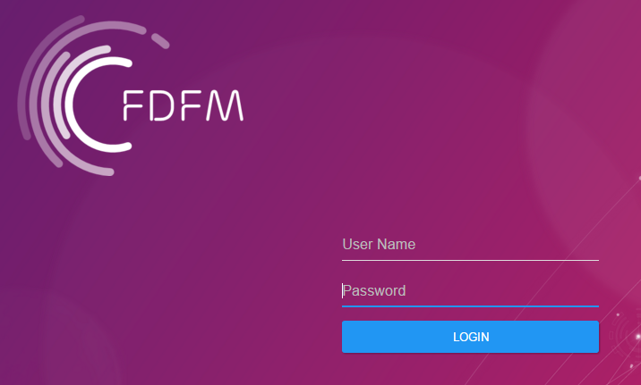
Phase #1 (SDP1) FDFM tool walkthrough.
Logon Server directly from the MPBN Network via a friendly GUI welcome screen.

Slide 7
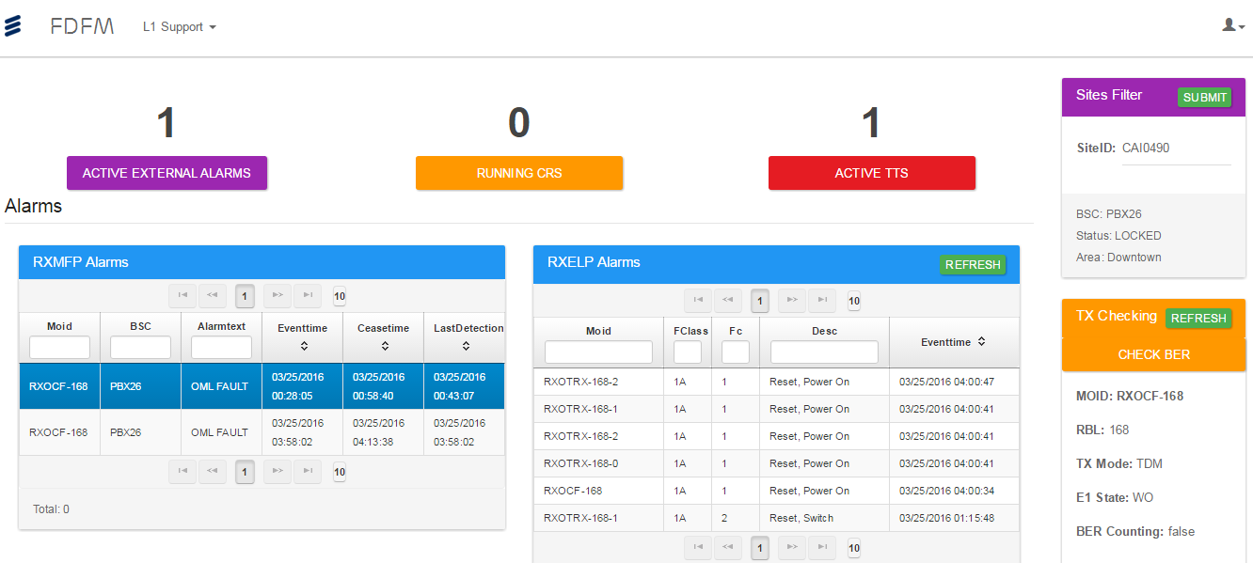
Phase #1 (SDP1) FDFM tool walkthrough.

Slide 8
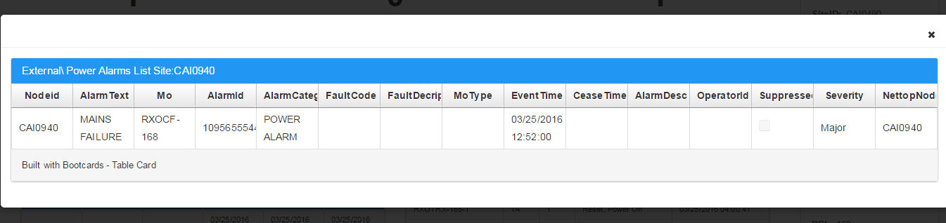
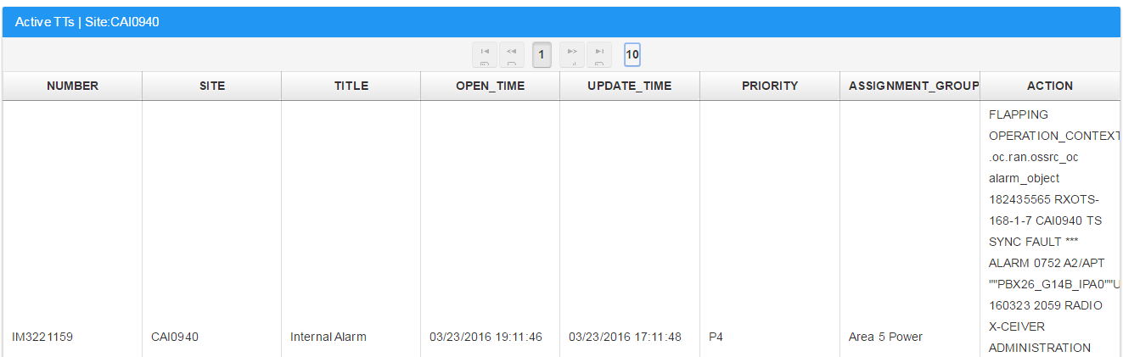
Phase #1 (SDP1) FDFM tool walkthrough.
Checking Active external Alarms instantly!
Checking Active Opened TTs for the site with a single click!

Slide 9
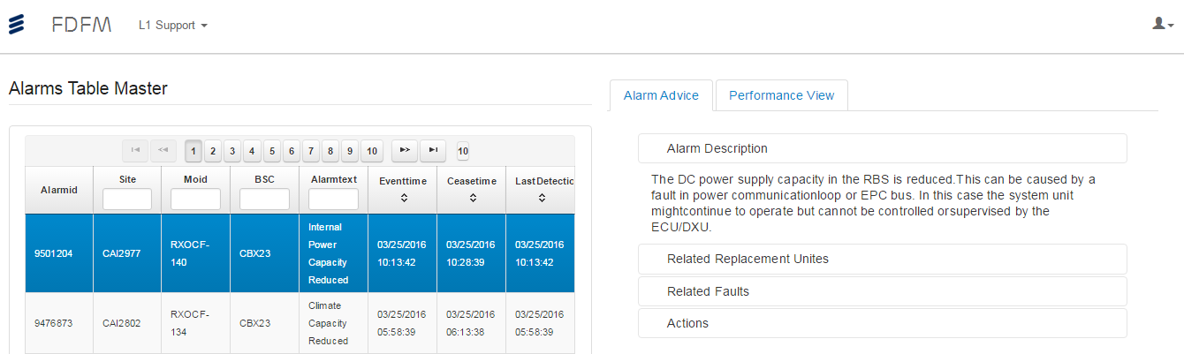
Phase #1 (SDP1) FDFM tool walkthrough.
Alarms FC Automatic Description.
Alarms FC Automatic Suspected HW Units.
Alarms FC Actions to follow for Clearance.

Slide 10
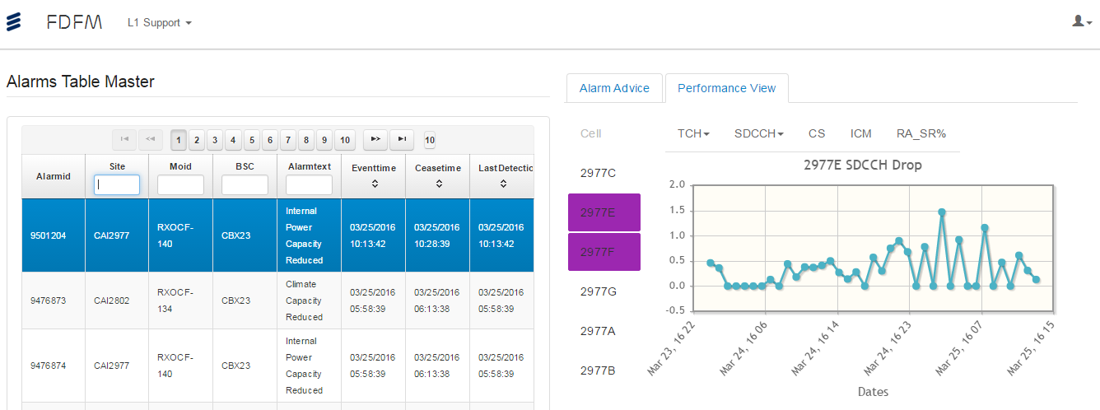
Phase #1 (SDP1) FDFM tool walkthrough.
KPIs analysis in less than <3 seconds!
All Cells main KPIs Breakdown checking <3 seconds!

Slide 11
Phase #1 (SDP1) FDFM Outputs & Achievements.
TTs MTTR Reduction after FDFM implementation.
 | Total | 30min : 1 Hr | 1 Hr : 1.5 Hrs | 1.5 Hr : 2 Hrs | > 2 Hrs | Ping pong | <30 Min
Feb | 765 | 232 | 68 | 48 | 88 | 43 | 329
March | 543 | 174 | 15 | 11 | 13 | 22 | 330
2 Hrs. SLA Violations Decreased By : -85.20%
1.5 Hrs. SLA Violations Decreased By : -77.00%
1 Hr. SLA Violations Decreased By : -77.99%
30 Min SLA Violations Decreased By : -25%
Ping Pong TTs Decreased By : -48.8%

Slide 12
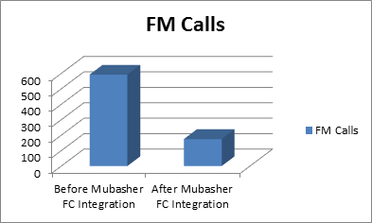
Phase #1 (SDP1) FDFM Outputs & Achievements.
FM Calls Reduction after Integrating the FC Collection from FDFM into “Mubasher” tool:
We had reached savings of FM calls from W51 2015 till W05 2016 = - 71.5% !!

Slide 13
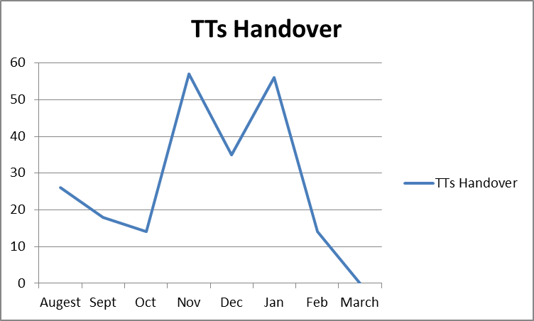
Phase #1 (SDP1) FDFM Outputs & Achievements.
TTs HANDOVER count between each shift after FDFM implementation:
We had reached 0 handover of TTs!!

Slide 14

Phase #1 (SDP1) FDFM Outputs & Achievements.
Team Collaboration and re-using of spare time:
AXE introduction & basic TT handling OPIs.
3G Introduction & basic 3G TT handling OPIs.
New WoW Ideas.
English skills learning.
Sessions of Knowledge Sharing.
Spare time Increase & increased TT accuracy.
L1 Support first dashboard introduction!
“Success is about freeing people to develop and build customer relationships. It’s about high-value activities”

Slide 15
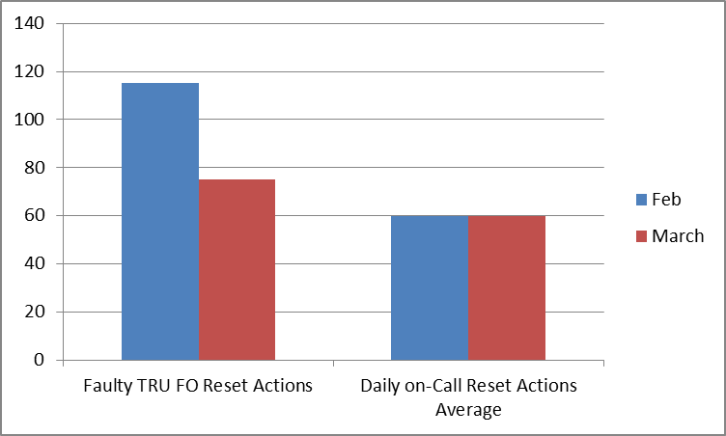
Phase #1 Cont. (SDP2) Reset Actions figures.
FO Reset Actions Average Statistics:
FO Resets from Faulty TRU Sheet // Daily Reset Actions Average:
FO Resets from STS / Shift team leader average:
 | Daily on-Call Reset Actions / Shift | Daily on-Call Reset Actions / Day | Daily on-Call Reset Actions / Month
March | 15 | 45 | 1350

Slide 16
Phase #1 Cont. (SDP2) Reset Actions figures.
L1 Support RESET Action Statistics:
TT Reset Average = 103 Reset / Month
FM Reset Average = 45 Reset / Month

Slide 17
Phase #1 Cont. (SDP2) Reset Actions effect on the Network KPIs.
Single TG With 3 Sectors Reset:
CELL | Carriers | SDCCH | BCCH
406A | 5 | 2 | 1
406B | 2 | 2 | 1
406D | 2 | 2 | 1
Substituting in a full 100% availability Network in 30 days:
 | Daily on-Call Reset Actions / Shift | Daily on-Call Reset Actions / Day | Daily on-Call Reset Actions / Month
March | 15 | 45 | 1350
- 45 sites (98.5) / 30 days // 1850 Site
Type | Average | 1-Dec
2G_Linear | 99.97 | 99.97
2G_Weighted | 99.54 | 99.54

Slide 18
Phase #1 Cont. (SDP2) Figures of outputs after including Auto Reset in FDFM tool. Phase#1 finalizing
Type | Average | 1-Nov
2G_Linear | 99.44 | 99.46
2G_Weighted | 99.73 | 99.81
100% - 99.46% = 0.54 %
Best case scenario of Reset Actions are contributing with at least 5.55% from total TCH Availability degradation!
Type | Average | 1-Dec
2G_Linear | 99.97 | 99.97
2G_Weighted | 99.54 | 99.54
100% - 99.97% = 0.03 %
Reduced Load on FO Dispatcher. No Reset actions manual.
Strict correct figures of reset actions made & their effect.
TCH Availability KPIs enhancement with at least 0.05%
Outage unknown reasons reduction.
Step forward for Automated Troubleshooting.

